Slide 1


Winning the Space
Race with Data Science
Angela Datcher
February 20, 2024

Slide 2
Outline
Executive Summary
Introduction
Methodology
Results
Conclusion
Appendix

Slide 3
Executive Summary
Summary of methodologies
Summary of all results
Data Collection through API
Data Collection with Web Scraping
Data Wrangling
Exploratory Data Analysis with SQL
Exploratory Data Analysis with Data Visualization
Interactive Visual Analytics with Folium
Machine Learning Prediction
Exploratory Data Analysis result
Interactive analytics in screenshots
Predictive Analytics result

Slide 4
Space X advertises Falcon 9 rocket launches on its website with a cost of 62 million dollars; other providers cost upward of 165 million dollars each, much of the savings is because Space X can reuse the first stage. Therefore, if we can determine if the first stage will land, we can determine the cost of a launch. This information can be used if an alternate company wants to bid against space X for a rocket launch. This goal of the project is to create a machine learning pipeline to predict if the first stage will land successfully.
Effects of payload mass, launch sites, number of flights and orbits on first-stage landing success
Rate of successful landings over time
Best predictive model for successful landing
Introduction
Find

Slide 5
Methodology

Slide 6
Methodology
Data collection methodology:
Data was collected using SpaceX API and web scraping from Wikipedia.
Perform data wrangling
One-hot encoding was applied to categorical features
Perform exploratory data analysis (EDA) using visualization and SQL
Perform interactive visual analytics using Folium and Plotly Dash
Perform predictive analysis using classification models
How to build, tune, evaluate classification models

Slide 7

Data Collection
The data was collected using various methods
Data collection was done using get request to the SpaceX API.
Next, we decoded the response content as a Json using .json() function call and turn it into a pandas dataframe using .json_normalize().
We then cleaned the data, checked for missing values and fill in missing values where necessary.
In addition, we performed web scraping from Wikipedia for Falcon 9 launch records with BeautifulSoup.
The objective was to extract the launch records as HTML table, parse the table and convert it to a pandas dataframe for future analysis.

Slide 8
Data Collection – SpaceX API
We used the get request to the SpaceX API to collect data, clean the requested data and did some basic data wrangling and formatting.
The link to the notebook is finalassignment/Week1_DataCollectionAPILab.ipynb at Capstone · adatcher/finalassignment (github.com)
Steps
Request data from SpaceX API (rocket launch data)
Decode response using .json() and convert to a dataframe using .json_normalize()
Request information about the launches from SpaceX API using custom functions
Create dictionary from the data
Create dataframe from the dictionary
Filter dataframe to contain only Falcon 9 launches
Replace missing values of Payload Mass with calculated .mean()
Export data to csv file

Slide 9
Data Collection - Scraping
We applied web scrapping to webscrap Falcon 9 launch records with BeautifulSoup
We parsed the table and converted it into a pandas dataframe.
The link to the notebook is finalassignment/Week1_DataCollectionWebScraping.ipynb at Capstone · adatcher/finalassignment (github.com)
Steps
Request data from Wikipedia
Create BeautifulSoup object
Extract column names
Collect data from parsing HTML tables
Create dictionary from the data
Create dataframe from the dictionary
Export data to csv file

Slide 10
Data Wrangling
The link to the notebook is finalassignment/Week1_DataWrangling.ipynb at Capstone · adatcher/finalassignment (github.com)
Steps
Perform EDA and determine data labels
Calculate:
# of launches for each site
# and occurrence of orbit
# and occurrence of mission outcome per orbit type]
Create binary landing outcome column (dependent variable)
Export data to csv file

Slide 11
EDA with Data Visualization
Charts
Flight Number vs. Payload
Flight Number vs. Launch Site
Payload Mass (kg) vs. Launch Site
Payload Mass (kg) vs. Orbit type
The link to the notebook is finalassignment/Week2_EDAwVisualization.ipynb at Capstone · adatcher/finalassignment (github.com)

Slide 12
EDA with SQL
We applied EDA with SQL to get insight from the data. We wrote queries to find out for instance:
The names of unique launch sites in the space mission.
The total payload mass carried by boosters launched by NASA (CRS)
The average payload mass carried by booster version F9 v1.1
The total number of successful and failure mission outcomes
The failed landing outcomes in drone ship, their booster version and launch site names.
The link to the notebook is finalassignment/Week2_EDAwSQL.ipynb at Capstone · adatcher/finalassignment (github.com)

Slide 13
Map with Folium
Markers Indicating Launch Sites
Added blue circle at NASA Johnson Space Center's coordinate with a popup label showing its name using its latitude and longitude coordinates
Added red circles at all launch sites coordinates with a popup label showing its name using its name using its latitude and longitude coordinates
Colored Markers of Launch Outcomes
Added colored markers of successful (green) and unsuccessful (red) launches at each launch site to show which launch sites have high success rates
We calculated the distances between a launch site to its proximities. We answered some question for instance:
Are launch sites near railways, highways and coastlines.
Do launch sites keep certain distance away from cities.

Slide 14
Build a Dashboard with Plotly Dash
Dropdown List with Launch Sites
Allow user to select all launch sites or a certain launch site
Slider of Payload Mass Range
Allow user to select payload mass range
Pie Chart Showing Successful Launches
Allow user to see successful and unsuccessful launches as a percent of the total
Scatter Chart Showing Payload Mass vs. Success Rate by Booster Version
Allow user to see the correlation between Payload and Launch Success
The link to the notebook is finalassignment/Week3_InteractiveDashwPlotlyDash.py at Capstone · adatcher/finalassignment (github.com)

Slide 15
Predictive Analysis (Classification)
The link to the notebook is finalassignment/Week4_PredictiveAnalytics.ipynb at Capstone · adatcher/finalassignment (github.com)
Charts
Create NumPy array
Standardize the data with StandardScaler. Fit and transform the data.
Split the data using train_test_split
Create a GridSearchCV object with cv=10 for parameter optimization
Apply GridSearchCV on different algorithms: logistic regression (LogisticRegression()), support vector machine (SVC()), decision tree (DecisionTreeClassifier()), K-Nearest Neighbor (KNeighborsClassifier())
Calculate accuracy on the test data
Assess the confusion matrix
Identify the best model

Slide 16

Insights Drawn from EDA

Slide 17
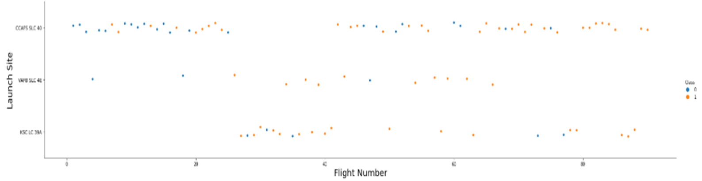
Flight Number vs. Launch Site
Earlier flights had a lower success rate (blue = fail)
Later flights had a higher success rate (orange = success)
Around half of launches were from CCAFS SLC 40 launch site
VAFB SLC 4E and KSC LC 39A have higher success rates

Slide 18
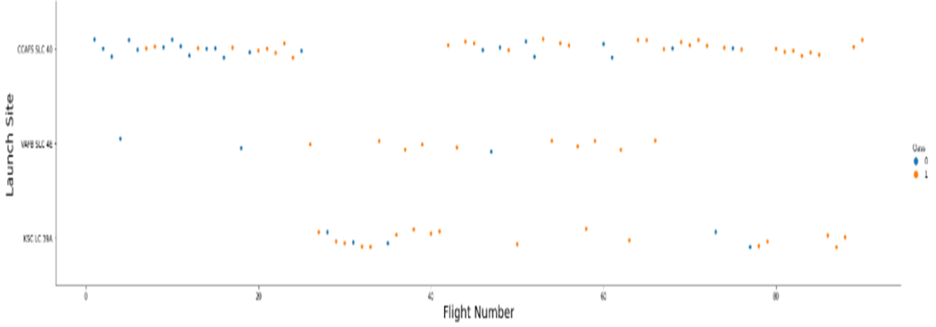
Payload vs. Launch Site
Typically, the higher the payload mass (kg), the higher the success rate
Most launces with a payload greater than 7,000 kg were successful
KSC LC 39A has a 100% success rate for launches less than 5,500 kg
VAFB SKC 4E has not launched anything greater than ~10,000 kg

Slide 19
Success Rate by Orbit
100% Success Rate: ES-L1, GEO, HEO and SSO
50%-80% Success Rate: GTO, ISS, LEO, MEO, PO
0% Success Rate: SO

Slide 20
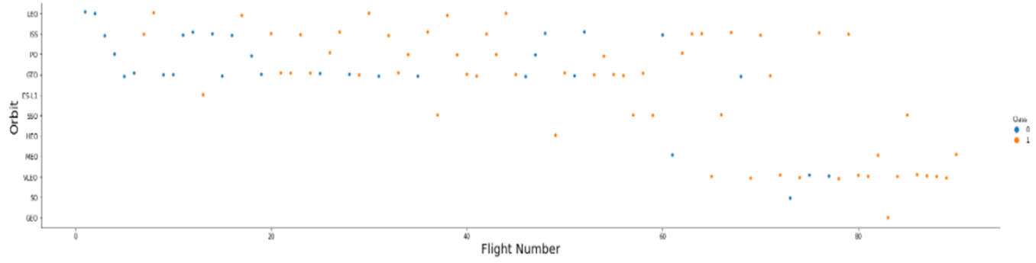
Flight Number vs. Orbit
The success rate typically increases with the number of flights for each orbit
This relationship is highly apparent for the LEO orbit
The GTO orbit, however, does not follow this trend

Slide 21
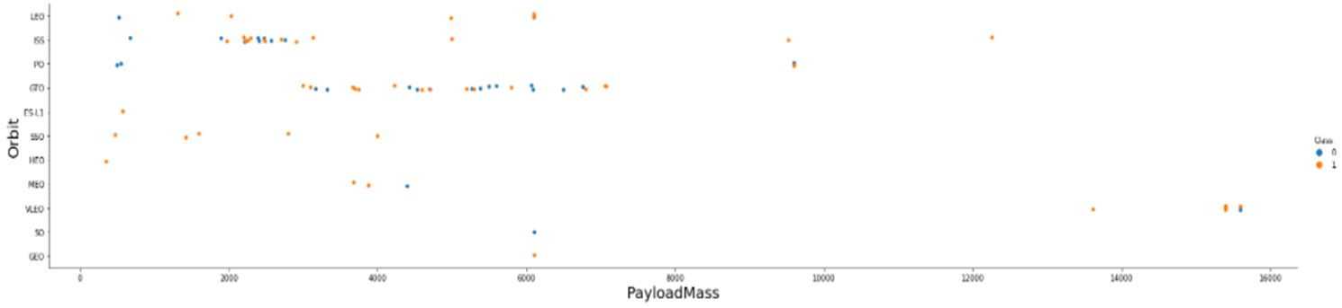
Payload vs. Orbit
Heavy payloads are better with LEO, ISS and PO orbits
The GTO orbit has mixed success with heavier payloads

Slide 22

Launch Success Yearly Trend
The success rate improved from 2013-2017 and 2018-2019
The success rate decreased from 2017-2018 and from 2019-2020
Overall, the success rate has improved since 2013

Slide 23

All Launch Site Names
Launch Site Names
CCAFS LC-40
CCAFS SLC-40
KSC LC-39A
VAFB SLC-4E

Slide 24
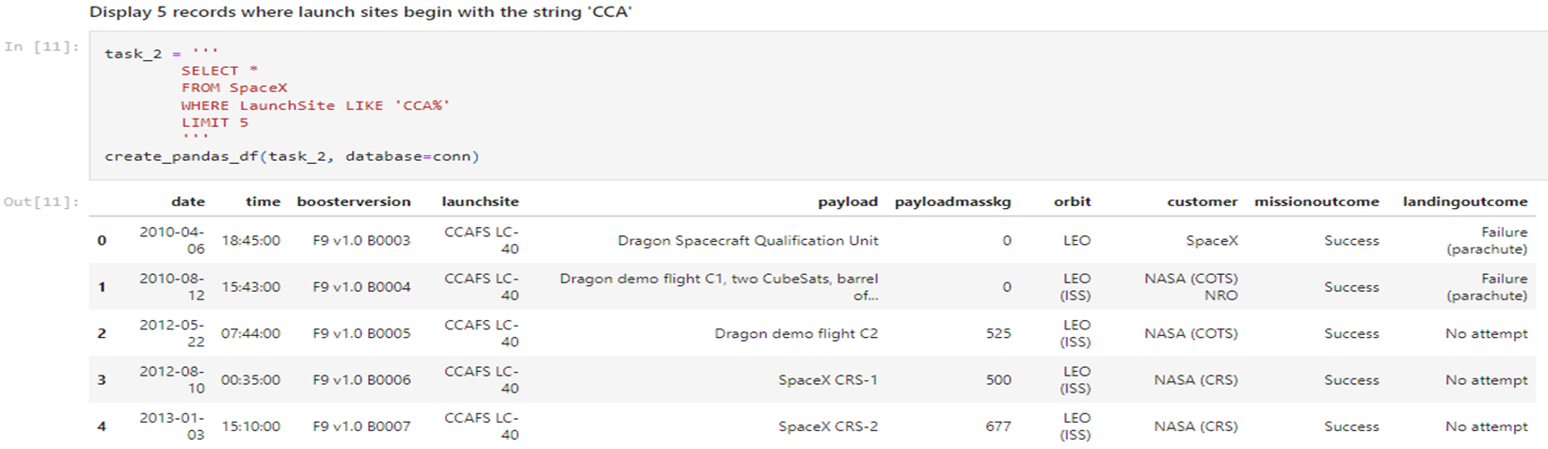
Launch Site Starting w/ CCA

Slide 25

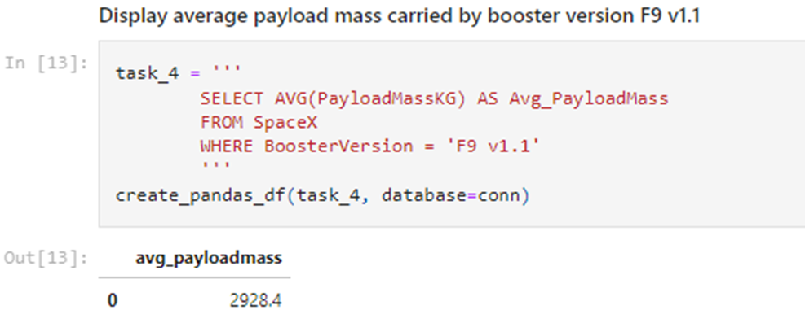
Total Payload Mass • 45,596 kg (total) carried by boosters launched by NASA (CRS)
Total Payload Mass
2,928 kg (average) carried by booster version F9 v1.1

Slide 26


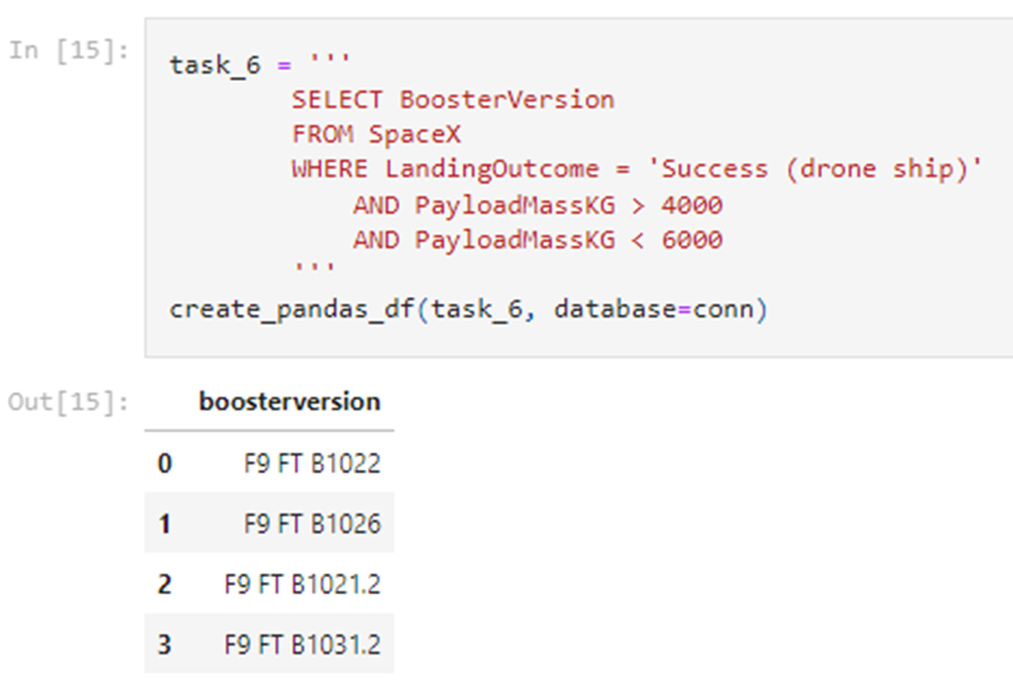
Landing & Mission Info
1st Successful Landing in Ground Pad 12/22/2015
Total Number of Successful and Failed Mission Outcomes
1 Failure in Flight, 99 Success, 1 Success (payload status unclear)
Booster Drone Ship Landing
Booster mass greater than 4,000 but less than 6,000
JSCAT-14, JSCAT-16, SES-10, SES-11 / EchoStar 105

Slide 27
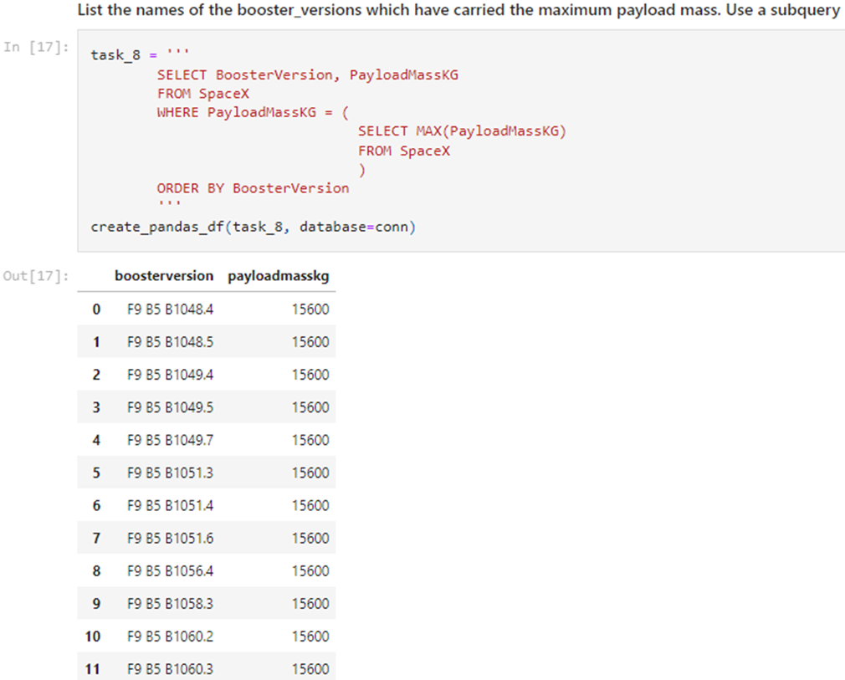
Boosters Carried Maximum Payload
Carrying Max Payload
F9 B5 B1048.4
F9 B5 B1049.4
F9 B5 B1051.3
F9 B5 B1056.4
F9 B5 B1048.5
F9 B5 B1051.4
F9 B5 B1049.5
F9 B5 B1060.2
F9 B5 B1058.3
F9 B5 B1051.6
F9 B5 B1060.3
F9 B5 B1049.7

Slide 28

2015 Launch Records
Showing month, date, booster version, launch site and landing outcome

Slide 29

Rank Landing Outcomes Between 2010-06-04 and 2017-03-20
Count of landing outcomes between 2010-06-04 and 2017-03-20 in descending order [ Total: 20]

Slide 30
Launch Sites Proximity Analysis

Slide 31

All launch sites global map markers

Slide 32

Markers showing launch sites with color labels

Slide 33

Launch Site distance to landmarks

Slide 34

Build a Dashboard with Plotly Dash

Slide 35

Launch Success by Site
KSC LC-39A has the most successful launches amongst launch sites (41.2%)

Slide 36

Launch Success (KSC LC-29A)
KSC LC-39A has the highest success rate amongst launch sites (76.9%)
• 10 successful launches and 3 failed launches

Slide 37
Predictive Analysis (Classification)

Slide 38

Classification Accuracy
All the models performed at about the same level and had the same scores and accuracy. This is likely due to the small dataset. The Decision Tree model slightly outperformed the rest when looking at .best_score_
.best_score_ is the average of all cv folds for a single combination of the parameters

Slide 39

Confusion Matrix
Precision = TP / (TP + FP)
12 / 15 = .80
Recall = TP / (TP + FN)
12 / 12 = 1
F1 Score = 2 * (Precision * Recall) / (Precision + Recall)
2 * (.8 * 1) / (.8 + 1) = .89
Accuracy = (TP + TN) / (TP + TN + FP + FN) = .833

Slide 40
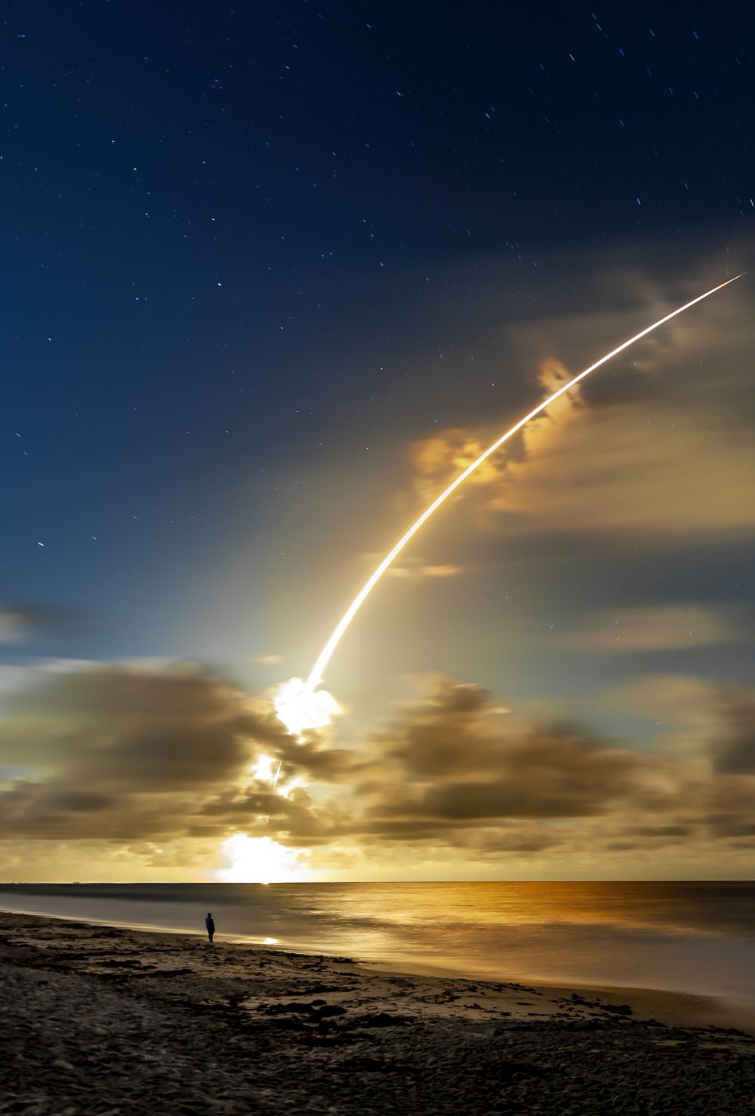
Conclusions
We can conclude that:
The larger the flight amount at a launch site, the greater the success rate at a launch site.
Launch success rate started to increase in 2013 till 2020.
Orbits ES-L1, GEO, HEO, SSO, VLEO had the most success rate.
KSC LC-39A had the most successful launches of any sites.
The Decision tree classifier is the best machine learning algorithm for this task.

Slide 41

Thank you!

